Slide 1
CMPS4252 Digital Logic and Design
Final Project
Osborn Collins and Mark Pascual
15th November 2022

Slide 2
Task
Design a soda machine dispenser for the IT department students' lounge.
Sodas cost only 25 cents each.
The machine accepts 5 cents, 10 cents, and shillings.
When enough coins have been inserted, the machine dispenses the soda and returns any necessary change.

Slide 3
Task
Design an FSM controller for the soda machine.
The FSM inputs are 5 cents, 10 cents, and shilling, indicating which coin was inserted.
Assume that exactly ONE coin is inserted on each cycle.
The outputs are Dispense, Return5Cents, Return10Cents, and ReturnTwo10Cents.

Slide 4
Task
When the FSM reaches 25 cents, it asserts Dispense and the necessary Return outputs required to deliver the appropriate change.
Then it should be ready to start accepting coins for another soda.

Slide 5
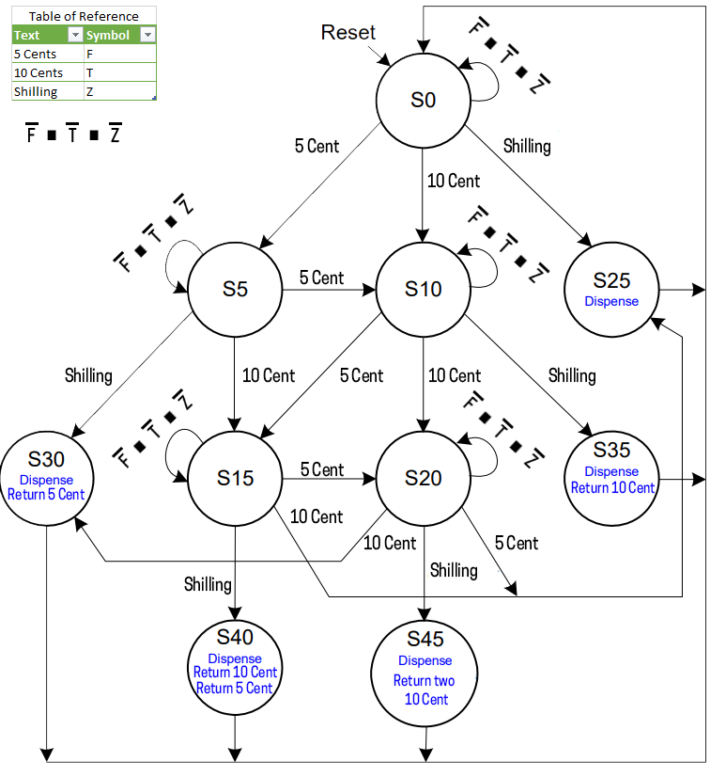
FSM

Slide 6
State encoding (using on hot encoding)
State | Encoding S_{9:0}
S0 | 0000000001
S5 | 0000000010
S10 | 0000000100
S25 | 0000001000
S30 | 0000010000
S15 | 0000100000
S20 | 0001000000
S35 | 0010000000
S40 | 0100000000
S45 | 1000000000

Slide 7
Definitions:
Definitions for the state transition table
5 cents → F
10 cents → T
Shilling → Z
Definitions for the output table
rF – Return 5 Cent
rT – Return 10 Cent
r2T – Return two 10 Cent

Slide 8
State transition table
Current state | Inputs |  |  | Next state
S | F (five cent) | T (ten cent) | Z (shilling) | S’
S0 | 0 | 0 | 0 | S0
S0 | 0 | 0 | 1 | S25
S0 | 0 | 1 | 0 | S10
S0 | 1 | 0 | 0 | S5
S5 | 0 | 0 | 0 | S5
S5 | 0 | 0 | 1 | S30
S5 | 0 | 1 | 0 | S15
S5 | 1 | 0 | 0 | S10
S10 | 0 | 0 | 0 | S10
S10 | 0 | 0 | 1 | S35
S10 | 0 | 1 | 0 | S20
S10 | 1 | 0 | 0 | S15
S25 | X | X | X | S0
S30 | X | X | X | S0
S15 | 0 | 0 | 0 | S15
S15 | 0 | 0 | 1 | S40
S15 | 0 | 1 | 0 | S25
S15 | 1 | 0 | 0 | S20
S20 | 0 | 0 | 0 | S20
S20 | 0 | 0 | 1 | S45
S20 | 0 | 1 | 0 | S30
S20 | 1 | 0 | 0 | S25
S35 | X | X | X | S0
S40 | X | X | X | S0
S45 | X | X | X | S0

Slide 9
State transition table with encoding
Current State S |  |  |  |  |  |  |  |  |  | Inputs |  |  | Next State S’
S₉ | S₈ | S₇ | S₆ | S₅ | S₄ | S₃ | S₂ | S₁ | S₀ | F | T | Z | S’₉ | S’₈ | S’₇ | S’₆ | S’₅ | S’₄ | S’₃ | S’₂ | S’₁ | S’₀
0 | 0 | 0 | 0 | 0 | 0 | 0 | 0 | 0 | 1 | 0 | 0 | 0 | 0 | 0 | 0 | 0 | 0 | 0 | 0 | 0 | 0 | 1
0 | 0 | 0 | 0 | 0 | 0 | 0 | 0 | 0 | 1 | 0 | 0 | 1 | 0 | 0 | 0 | 0 | 0 | 0 | 1 | 0 | 0 | 0
0 | 0 | 0 | 0 | 0 | 0 | 0 | 0 | 0 | 1 | 0 | 1 | 0 | 0 | 0 | 0 | 0 | 0 | 0 | 0 | 1 | 0 | 0
0 | 0 | 0 | 0 | 0 | 0 | 0 | 0 | 0 | 1 | 1 | 0 | 0 | 0 | 0 | 0 | 0 | 0 | 0 | 0 | 0 | 1 | 0
0 | 0 | 0 | 0 | 0 | 0 | 0 | 0 | 1 | 0 | 0 | 0 | 0 | 0 | 0 | 0 | 0 | 0 | 0 | 0 | 0 | 1 | 0
0 | 0 | 0 | 0 | 0 | 0 | 0 | 0 | 1 | 0 | 0 | 0 | 1 | 0 | 0 | 0 | 0 | 0 | 1 | 0 | 0 | 0 | 0
0 | 0 | 0 | 0 | 0 | 0 | 0 | 0 | 1 | 0 | 0 | 1 | 0 | 0 | 0 | 0 | 0 | 1 | 0 | 0 | 0 | 0 | 0
0 | 0 | 0 | 0 | 0 | 0 | 0 | 0 | 1 | 0 | 1 | 0 | 0 | 0 | 0 | 0 | 0 | 0 | 0 | 0 | 1 | 0 | 0
0 | 0 | 0 | 0 | 0 | 0 | 0 | 1 | 0 | 0 | 0 | 0 | 0 | 0 | 0 | 0 | 0 | 0 | 0 | 0 | 1 | 0 | 0
0 | 0 | 0 | 0 | 0 | 0 | 0 | 1 | 0 | 0 | 0 | 0 | 1 | 0 | 0 | 1 | 0 | 0 | 0 | 0 | 0 | 0 | 0
0 | 0 | 0 | 0 | 0 | 0 | 0 | 1 | 0 | 0 | 0 | 1 | 0 | 0 | 0 | 0 | 1 | 0 | 0 | 0 | 0 | 0 | 0
0 | 0 | 0 | 0 | 0 | 0 | 0 | 1 | 0 | 0 | 1 | 0 | 0 | 0 | 0 | 0 | 0 | 1 | 0 | 0 | 0 | 0 | 0
0 | 0 | 0 | 0 | 0 | 0 | 1 | 0 | 0 | 0 | X | X | X | 0 | 0 | 0 | 0 | 0 | 0 | 0 | 0 | 0 | 1
0 | 0 | 0 | 0 | 0 | 1 | 0 | 0 | 0 | 0 | X | X | X | 0 | 0 | 0 | 0 | 0 | 0 | 0 | 0 | 0 | 1
0 | 0 | 0 | 0 | 1 | 0 | 0 | 0 | 0 | 0 | 0 | 0 | 0 | 0 | 0 | 0 | 0 | 1 | 0 | 0 | 0 | 0 | 0
0 | 0 | 0 | 0 | 1 | 0 | 0 | 0 | 0 | 0 | 0 | 0 | 1 | 0 | 1 | 0 | 0 | 0 | 0 | 0 | 0 | 0 | 0
0 | 0 | 0 | 0 | 1 | 0 | 0 | 0 | 0 | 0 | 0 | 1 | 0 | 0 | 0 | 0 | 0 | 0 | 0 | 1 | 0 | 0 | 0
0 | 0 | 0 | 0 | 1 | 0 | 0 | 0 | 0 | 0 | 1 | 0 | 0 | 0 | 0 | 0 | 1 | 0 | 0 | 0 | 0 | 0 | 0
0 | 0 | 0 | 1 | 0 | 0 | 0 | 0 | 0 | 0 | 0 | 0 | 0 | 0 | 0 | 0 | 1 | 0 | 0 | 0 | 0 | 0 | 0
0 | 0 | 0 | 1 | 0 | 0 | 0 | 0 | 0 | 0 | 0 | 0 | 1 | 1 | 0 | 0 | 0 | 0 | 0 | 0 | 0 | 0 | 0
0 | 0 | 0 | 1 | 0 | 0 | 0 | 0 | 0 | 0 | 0 | 1 | 0 | 0 | 0 | 0 | 0 | 0 | 1 | 0 | 0 | 0 | 0
0 | 0 | 0 | 1 | 0 | 0 | 0 | 0 | 0 | 0 | 1 | 0 | 0 | 0 | 0 | 0 | 0 | 0 | 0 | 1 | 0 | 0 | 0
0 | 0 | 1 | 0 | 0 | 0 | 0 | 0 | 0 | 0 | X | X | X | 0 | 0 | 0 | 0 | 0 | 0 | 0 | 0 | 0 | 1
0 | 1 | 0 | 0 | 0 | 0 | 0 | 0 | 0 | 0 | X | X | X | 0 | 0 | 0 | 0 | 0 | 0 | 0 | 0 | 0 | 1
1 | 0 | 0 | 0 | 0 | 0 | 0 | 0 | 0 | 0 | X | X | X | 0 | 0 | 0 | 0 | 0 | 0 | 0 | 0 | 0 | 1

Slide 10

Boolean Equations
S’₉ = S₆Z
S’₈ = S₅Z
S’₇ = S₂Z
S’₆ = S₂T + S₅F + S₆$\overline{F}\overline{T}\overline{Z}$
S’₅ = S₁T + S₂F + S₅$\overline{F}\overline{T}\overline{Z}$

Slide 11

Boolean Equations
S’₄ = S₁Z + S₆T
S’₃ = S₀Z + S₅T + S₆F
S’₂ = S₀T + S₁F + S₂$\overline{F}\overline{T}\overline{Z}$
S’₁ = S₀F + S₁$\overline{F}\overline{T}\overline{Z}$
S’₀ = S₁$\overline{F}\overline{T}\overline{Z}$ + S₃ + S₄ + S₇ + S₈ + S₉

Slide 12
Output Table
Current State | Dispense | rF | rT | r2T
S25 | 1 | X | X | X
S30 | 1 | 1 | X | X
S35 | 1 | X | 1 | X
S40 | 1 | 1 | 1 | X
S45 | 1 | X | X | 1

Slide 13
Output Table with Encoding
Current State |  |  |  |  |  |  |  |  |  | Output
S₉ | S₈ | S₇ | S₆ | S₅ | S₄ | S₃ | S₂ | S₁ | S₀ | Dispense | rF | rT | r2T
0 | 0 | 0 | 0 | 0 | 0 | 1 | 0 | 0 | 0 | 1 | X | X | X
0 | 0 | 0 | 0 | 0 | 1 | 0 | 0 | 0 | 0 | 1 | 1 | X | X
0 | 0 | 1 | 0 | 0 | 0 | 0 | 0 | 0 | 0 | 1 | X | 1 | X
0 | 1 | 0 | 0 | 0 | 0 | 0 | 0 | 0 | 0 | 1 | 1 | 1 | X
1 | 0 | 0 | 0 | 0 | 0 | 0 | 0 | 0 | 0 | 1 | X | X | 1

Slide 14
Boolean Equations for the Output
Dispense = S₃ + S₄ + S₇ + S₈ + S₉
rF = S₄ + S₈
rT = S₇ + S₈
r2T = S₉

Slide 15
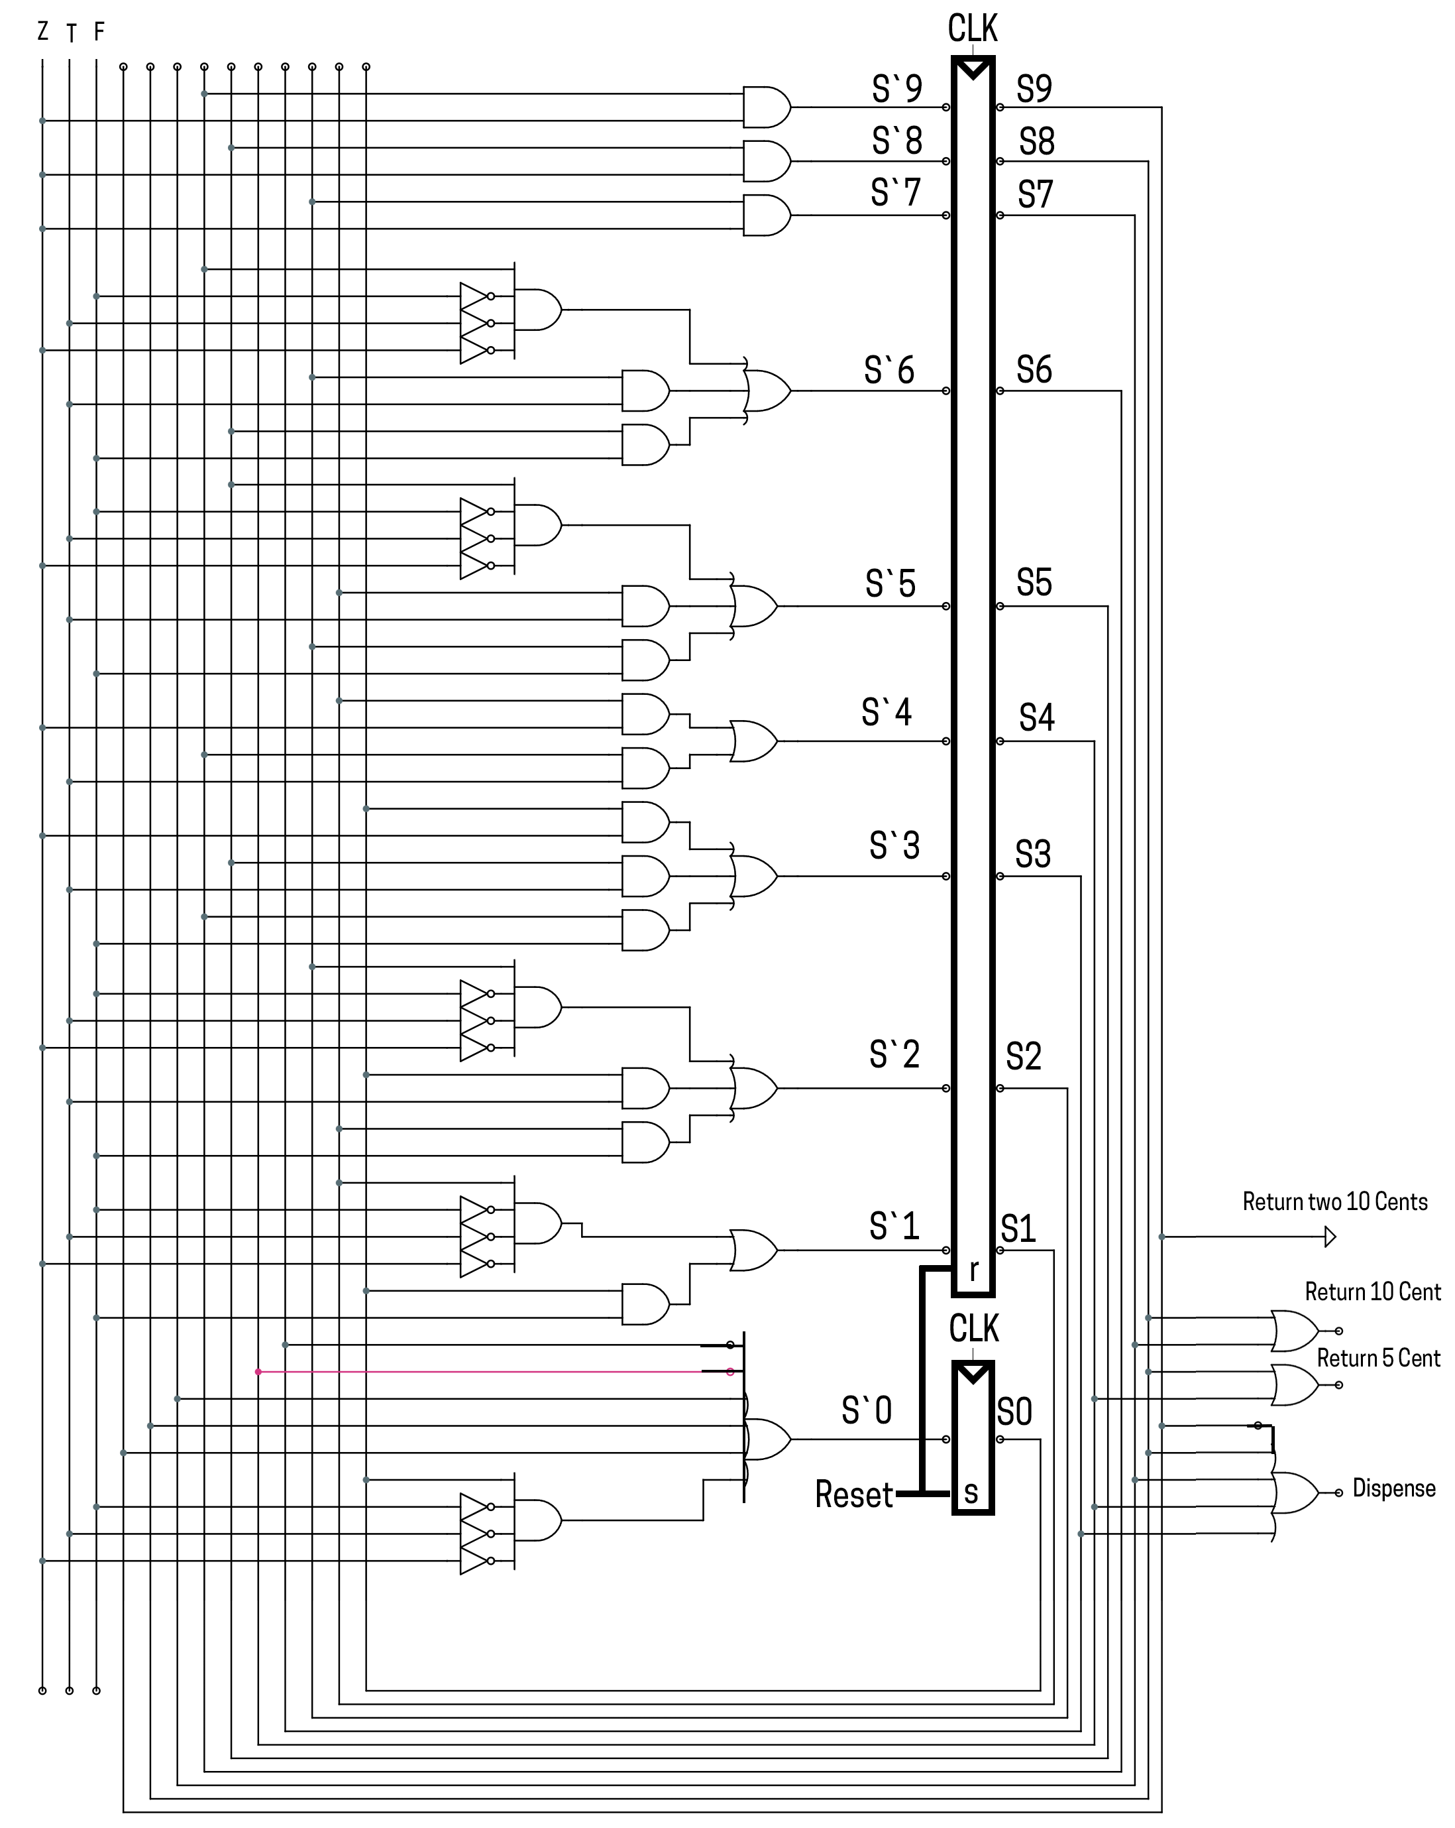
Circuit Diagram

Slide 16
The End
Questions?

